Slide 1
Introduction to Clinically Relevant Microbiology
Edward L. Goodman, MD
Core Faculty
August 5, 2019

Slide 2
Outline
Major Groups of Bacteria Encountered
An Overview of What the Micro Lab Does
Newer Technology
A Few “Pearls”
A Primer on Susceptibility Testing
Review of some resistance mechanisms
Summary of “Everything You Wanted to Know about Antibiotics…”

Slide 3
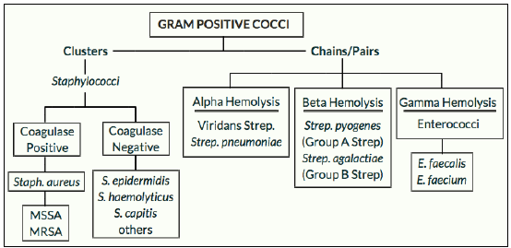

Slide 4
Gram Positive Pathogens
Staphylococcus aureus (includes OSSA and MRSA)
  Hints about detecting
    On gram stain: GPC in clusters
    Coagulase positive = Staph aureus
    Grow rapidly in blood cultures (<12 hours)
  99% beta lactamase producing = penicillin resistant
  MRSA 52%
    When considering S aureus as a pathogen, must cover MRSA until ruled out
Staphylococcus epidermidis and other coag negative staph
  Usually “heteroresistant” = methicillin resistant
  But if lab shows “oxacillin sensitive,” believe it (and stop vanc!)

Slide 5
Streptococci
Beta hemolytic
  “Always” penicillin and cephalosporin sensitive
    After 70+ years, still no resistance to penicillin G
  Aggressive, just like S. aureus
  Necrotizing Group A Strept/Toxic Shock require anti-toxin therapy as well
    Clindamycin or linezolid are drugs that affect protein synthesis; toxins are proteins
Viridans
  Almost always sensitive to Ceftriaxone. Penicillin sensitivity variable

Slide 6
Enterococcus
Inhibited but not killed by beta lactam monotherapy
For endocarditis, require “bactericidal” therapy
  Penicillin or ampicillin plus aminoglycoside
  Alternative penicillin or ampicillin plus ceftriaxone!
For non endocarditis, does not require ‘cidal therapy, so no need for combined therapy
VRE common with only 35% of E faecium susceptible to vanc
  Choices include ampicillin for E faecalis; linezolid, dapto and tigecycline for E faecium.
  Still requires “contact precautions” during active infection

Slide 7
Aerobic Gram Negative Rods
Enterobacteriaceae: E coli, Klebsiella, Proteus, Serratia, Shigella, Salmonella, Citrobacter, etc.
  Grow aerobically and anaerobically
    Can grow in anaerobic as well as aerobic blood culture bottle
  Increasing mechanisms of resistance (more later)
Non fermenters: Pseudomonas, Acinetobacter
  Inherently drug resistant and increasing acquired resistance
  Only grow in aerobic blood culture bottle
  Opportunistic pathogens
  Often require combination empiric therapy until susceptibility proven
    No evidence that double coverage protects against emergence of resistance

Slide 8
Anaerobes: think of when dealing with infections coming from or adjacent to mucosal surfaces
Gram negative: Bacterioides, fusobacteria
  Usually beta lactamase producing
  Usually part of mixed flora
  Distinct gram stain appearance and putrid odor
    Proteus also have a distinct foul odor (H₂S)
Gram positive: peptococci/peptostrept and clostridia
  Not beta lactamase producing = penicillin Rx effective
  More aero-tolerant and less susceptible to metronidazole
    Aspiration pneumonia – don’t use metronidazole alone

Slide 9
What Does the Micro Lab Do?
Bacteriology: aerobic, anaerobic (on some*) mycobacteria, fungi
  Blood*
  Urine
  Respiratory
  Stool
  Wounds*
  Sterile body fluids*
  Tissue*
Serology
Molecular

Slide 10
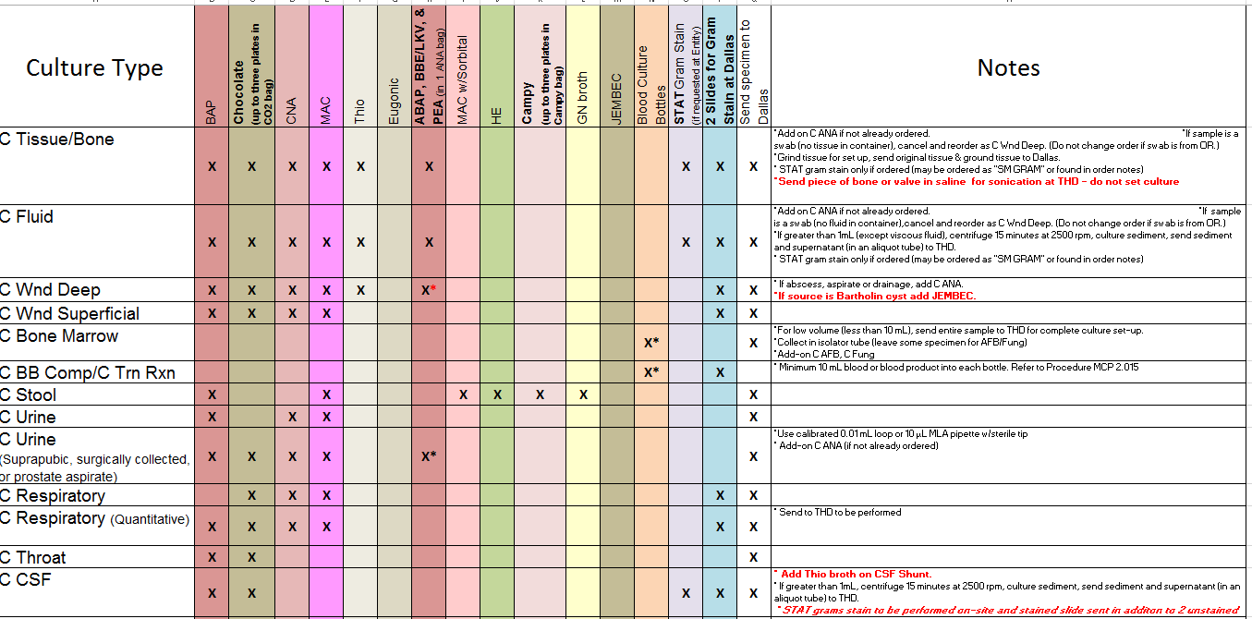
An Example of Micro Choices Based on Source

Slide 11
Mycobacteria
Typical = M. tuberculosis
  AFB smear from sputum = place patient in Airborne Precautions when ordered
  Send three smears at 8 hour intervals, preferable one in early AM
    If all three negative, Infection Prevention may allow Airborne Precautions to cease
    Always check with IP before stopping Airborne
  Direct PCR on sputum available for M. Tb as well as RIF resistance
    Automatically performed by the microbiology lab on AFB direct smear positive respiratory samples
  MALDI-TOF is now the primary method of speciation of AFB
    More about MALDI later

Slide 12
Atypical Mycobacteria
Slow growers
  M. avium
    Mimics TB
    Disseminated in HIV
  M. kansasii
    Mimics TB
  M. marinum
    Aquarium, extremities, lower temperature
Rapid growers = resistant to standard TB drugs
  M. fortuitum
  M. chelonei
  M. abscessus

Slide 13
Mycology
Yeasts
  Candida
  Cryptococcus
  Sporotrichosis
Hyphae formers
  Dimorphic = geographic
    Histo, Cocci, Blasto
  Opportunistic
    Aspergillis
    Zygomycetes
    Fusarium

Slide 14
Parasitology
Protozoans (do not cause eosinophilia)
  Malaria = rapid antigen test, thick and thin smears
  Amoeba = rapid antigen test, serology
  Giardia = rapid antigen test
  Leishmania = histopathology
Worms = detected by microscopy (eggs and segments)
  Tissue invasion associated with eosinophilia
  Roundworms (Ascaris, Strongyloides, Necator, Enterobius)
  Flukes (Schistosomiasis, Fasciola)
  Tapeworms (Taenia)

Slide 15
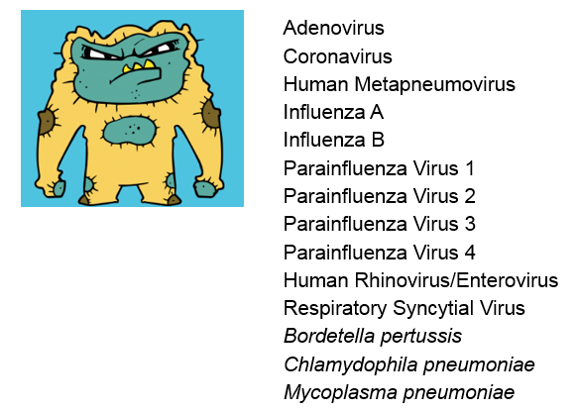
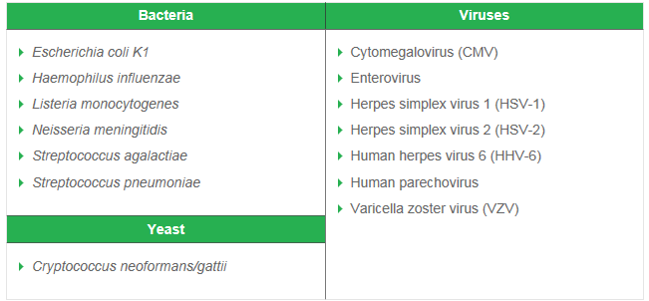
Virology and “Panels”
No longer culture technology, only PCR and serology
  Cultures were slow and tedious, not very sensitive
Respiratory panel
CSF panel

Slide 16
Unique Features of Microbiology Lab
Susceptibility tests often lead directly to treatment
  No other lab has that influence
  Imagine a report that says:
    “K is 3.0. Treat with 40 meq KCL!”
    “Hgb 6.7. Treat with 2 u packed RBC”
    But a urine culture growing 100,000 CFU of E coli susceptible to levofloxacin almost always leads to an order!! Just like Dr. Strangelove’s mechanical arm.

Slide 17
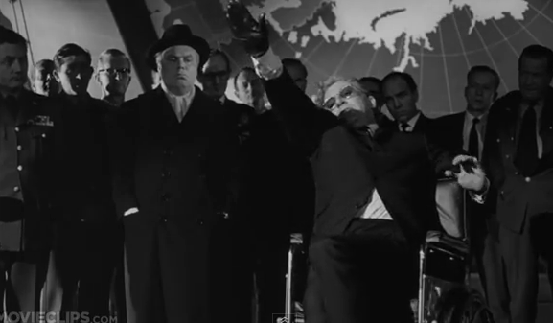
http://youtu.be/mzddAYYDZkk

Slide 18
Technology in Micro
Automated blood culture detection = 24/7 positive results called to patient’s nurse
Rapid susceptibility testing
  For most common organisms, MIC is resulted in 18 hours after growth on solid media
Molecular detection of resistance genes is available 4 hours from detection in liquid media – look for it in EMR or call
  On gram positive, can detect S. aureus, Coag neg staph and Mec A (=MRSA.)
    Report that states “Staph species” does not mean coag neg. It still could be S. aureus.
  Gram negative = many enterobacteriaceae species, some ESBL targets. Not detecting an ESBL does not rule ESBL out. Have to wait on MICs
Nucleic acid amplification: N. gonorrhea, C. trachomatis on voided urine in men, as well as penile or cervical discharge
DNA probe for Mycobacteria tuberculosis
MALDI-TOF = Mass spectrometry time of flight
  Used for mycobacteria species

Slide 19
A Virtual Tour of the Micro Lab!

Slide 21
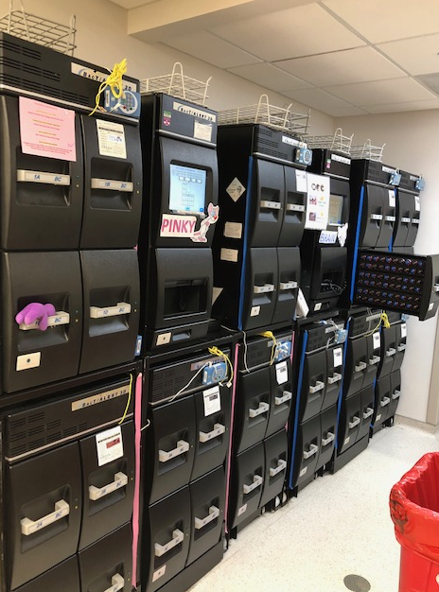
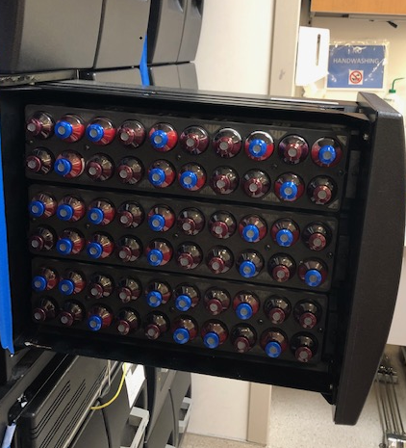
BacT Alert Blood Culture Incubators

Slide 22
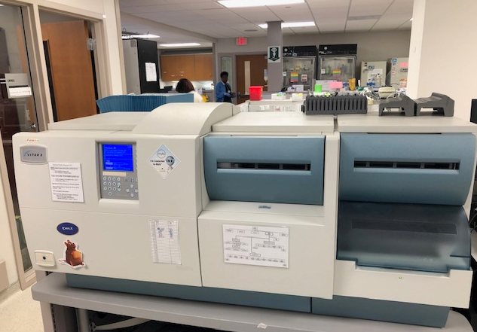
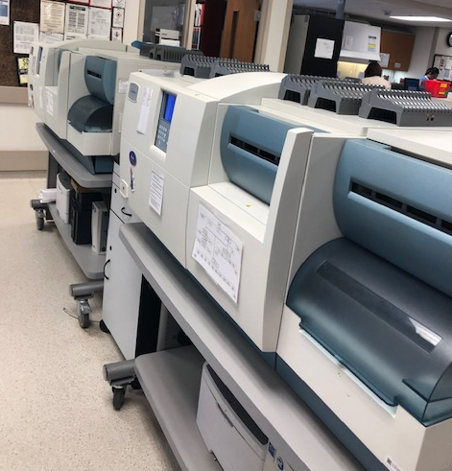
Vitek AST instruments

Slide 23
Verigene
Positive Blood Culture Rapid Identification with Resistance Genes
Bordetella PCR

Slide 24
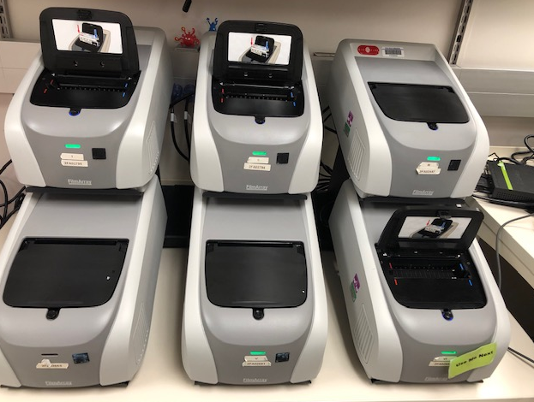
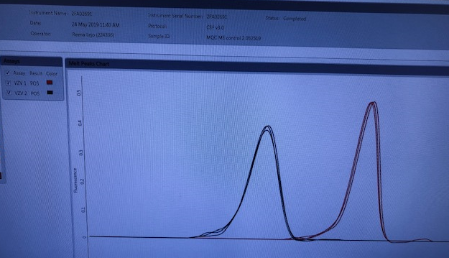
FilmArray
Respiratory Viral PCR and Meningitis

Slide 25
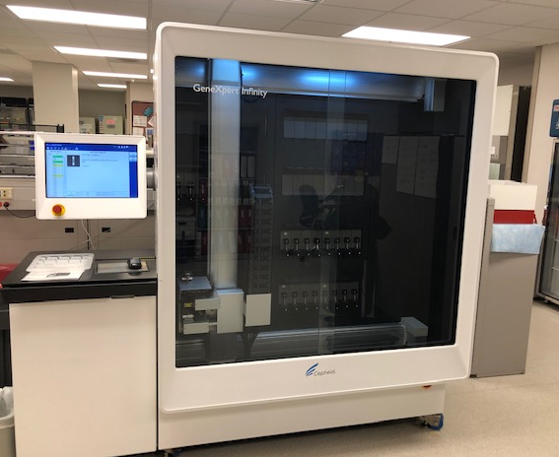
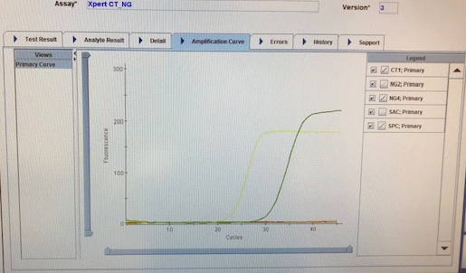
Cepheid Infinity
MTB PCR, CT/GC, GBS, FVL/PT Mutations, MRSA, Enterovirus, Blood Culture PCR

Slide 26
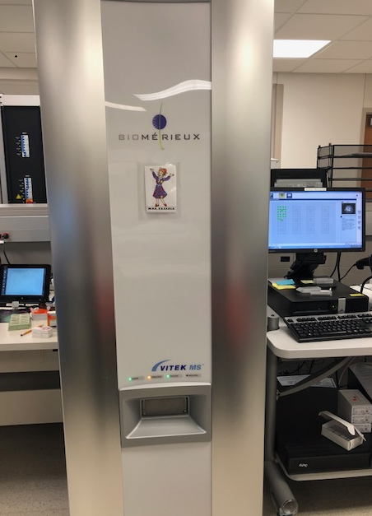
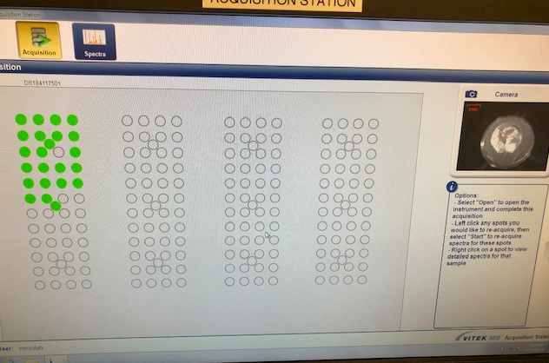
MALDI-TOF

Slide 27
Some “Pearls”
Swabs only for throat; cervical and urethral swabs require special GC media
  For abscesses, NEVER SEND SWAB. Instead promptly send liquid pus in capped syringe
Gram stain showing GNR but no aerobic growth, think of anaerobes
Anaerobic cultures only from abscesses, blood, tissue
  Never from sputum, stool, urine, genital, CSF (OR YOU WILL BE LAUGHTED AT!)
  Why? These sites have a normal anaerobic flora
Blood culture for GPC positive within <12 hours = likely S. aureus
Growth in anaerobic bottle only could be enterobacteraciae (E coli, etc), Strept pneumo or anaerobes, although anaerobes grow slower than aerobes
Growth in aerobic bottle only could be enterobacteraciae or non-fermenters (Pseudomonas, Acinetobacter)

Slide 28
More Pearls
Nucleic Acid Amplification Tests (NAAT) for gonorrhea and chlamydia are only for voided urine in men, cervical or penile discharge.
  Do not allow susceptibilities, only detection of DNA
Neisseria gonorrhea is very fastidious, requiring X and V factors present in chocolate agar.
  For sterile body fluid (joints, CSF) chocolate agar can grow N. gonorrhea and everything else
  For mucosal sites (pharynx, cervix, rectum, urethra), since chocolate agar grows EVERYTHING so must use Selective Inhibitory Agar (Jembec chocolate plates with VCN) with CO2 tablet.
    Call Micro Lab (X6350) for the appropriate media
  Whenever a culture for gonorrhea is sent, IT MUST BE IMMEDIATELY TAKEN TO LAB or isolates will die
    Take it yourself!

Slide 29
Susceptibility Testing
For aerobic/facultative bacteria only
For anaerobes, fungi, mycobacteria, it is a “send out” – results take days
Cascade reporting is a requirement for Antibiotic Stewardship
  Reporting broad spectrum drugs only when there is resistance to narrow spectrum drugs
Suppressing drugs
  If inappropriate for the site –e.g., nitrofurantoin for E coli in blood
  If not in the formulary
So, if you are using a drug that is not on the susceptibility panel, there is a reason – no need to call Micro to test it or release result.

Slide 30

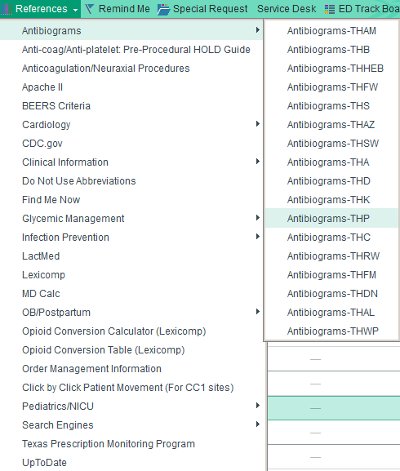
How To Find the Antibiogram

Slide 31
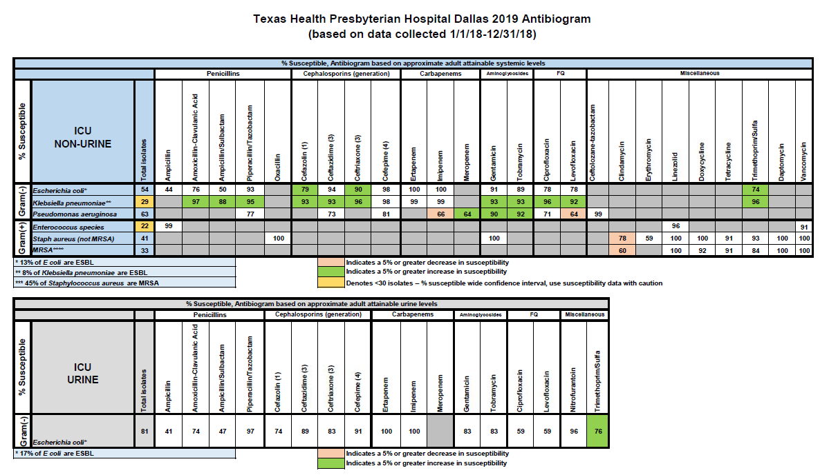

Slide 32
How Does a Patient Differ from a Test Tube?
Patient | Lab Test = “test tube”
Has excretory organs | None
Drug levels are not constant | Constant
Sequestered foci where drugs penetrate poorly | Uniform distribution of drug
Protein binding of drugs: only unbound is active | No protein in liquid media, all drug is active
Antimicrobial activity: PMN’s, globulins, complement | No other antimicrobial activity

Slide 33
Therefore, Susceptibilities Can Over or Underestimate Activity
Cephalothin (obsolete precursor to cefazolin) was active against Strept pneumo
  But didn’t work in meningitis.
  Why? No active drug penetration into CSF, only an inactive metabolite.
Ampicillin inactive against all Klebsiella
  Yet it can work in simple UTI (cystitis in a woman.)
  Why? Concentration in urine well above MIC
The original form of imipenem could treat E coli bacteremia but not UTI
  Why, it was inactivated in kidney due to an enzyme (dihydropeptidase)
  Addition of cilastatin inactivated enzyme that inactivated imipenem!

Slide 34
Types of Susceptibility Testing
Disc diffusion give zone sizes
  Kirby Bauer
  Do not allow comparison between drugs
  Still in use for selected isolates for which MIC can’t be done:
Dilution determine Minimum Inhibitory Concentration (MIC)
  Tube dilution
  Microtube dilution
  Agar plate dilution
Hybrid test = E test

Slide 35
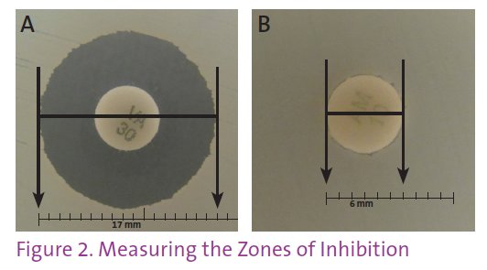
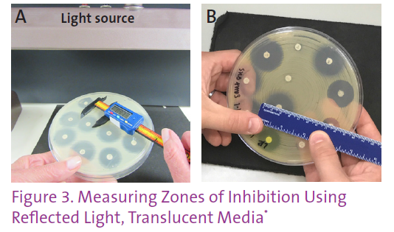
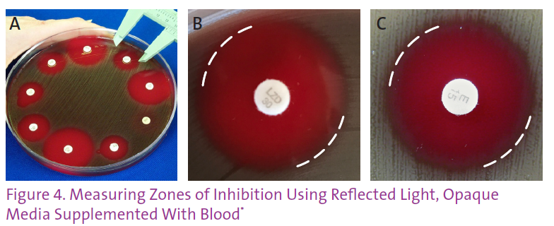
Disc diffusion – Kirby Bauer
CLSI. Disk Diffusion Reading Guide; First Edition. CLSI Quick Guide M02-QG

Slide 36
Vitek AST instruments = Microtiter MIC

Slide 37
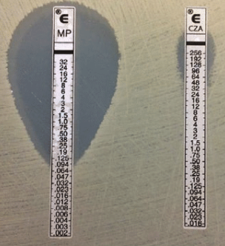
Etest

Slide 38
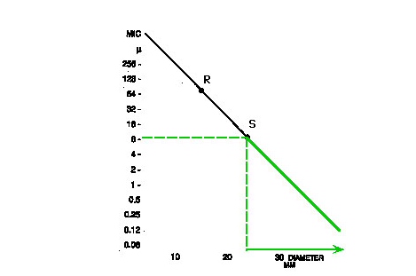
Relationship between MIC and Zone Size
Log₂ on vertical axis

Slide 39
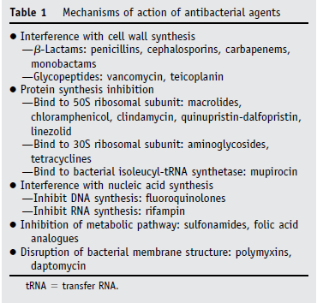
Mechanisms of Antimicrobial Activity
FC Tenover Amer J Med 2006;119: S3-10

Slide 40
DNA gyrase
DNA-directed RNA polymerase
Quinolones
Cell wall synthesis
Rifampin
ß-lactams & Glycopeptides (Vancomycin)
DNA
THFA
mRNA
Trimethoprim
Protein synthesis inhibition
Ribosomes
Folic acid synthesis
DHFA
50
50
50
Macrolides & Lincomycins
30
30
30
Sulfonamides
PABA
Protein synthesis inhibition
Protein synthesis mistranslation
Tetracyclines
Aminoglycosides
Cohen. Science 1992; 257:1064

Slide 41
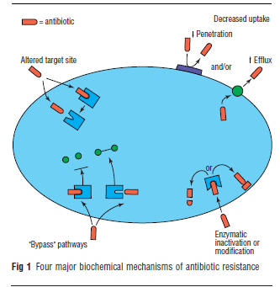
Mechanisms of Antibiotic Resistance
PM Hawkey, The origins and molecular basis of antibiotic resistance. Brit Med J 1998;317: 657-660

Slide 42
A Primer on Beta Lactamases

Slide 43
Class C - Cephalosporinases
AmpC
Cephalosporinases that hydrolyze penicillins, cephalosporins, monobactams, and cephamycins, but not the 4th generation cephalosporins or carbapenems
Resistant to beta-lactamase inhibitors; clavulanic acid induces AmpC enzyme production
SPICE-HaM instrinsic AmpC
Resistance genes are usually encoded on chromosomes (intrinsic)
Some plasmid mediated AmpC observed (associated with other genetic resistance)
Activity induced in the presence of β-lactam antibiotics
Jour Clin Micro. 2010 Apr; 48(4): 1019–1025
Notes:
Yes. The phenotypic confirmatory test does not detect all ESBLs. Some organisms with ESBLs contain other β-lactamases that can mask ESBL production in the phenotypic test, resulting in a false-negative test. These β-lactamases include AmpCs and inhibitor-resistant TEMs (IRTs). Hyper-production of TEM and/or SHV β-lactamases in organisms with ESBLs also may cause false-negative phenotypic confirmatory test results
AmpC is normally produced in low levels by many organisms and is not associated with resistance, but it can be produced at high levels and cause resistance.
Resistance may not be detectable initially, but appears after a period of exposure to beta-lactam antibioticsOther organisms in that can harbor AmpC include: Acinetobacter, Cronobacter, Edwardsiella, Hafnia, Morganella, and rarely Pseudomonas

Slide 44
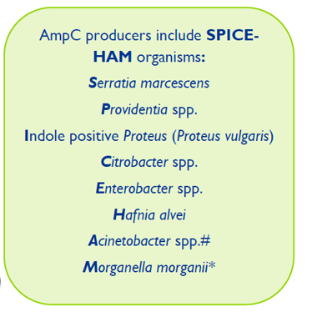
http://extcontent.covenanthealth.ca/CHASE_Issue_12_-_ESBL_AmpC.pdf

Slide 45
Amp C - Continued
Constituent Production
  A tiny minority of strains are overproducers of Amp C cephalosporinase
  Not detected by standard lab MICs
  When the majority (susceptible) strains are eliminated, the mutant overproducers survive and thrive
  Not inhibited by beta lactamase inhibitors
Classic Darwinian Selection –
  “survival of the fittest.”
  Those not producing Amp C are killed leaving behind Amp C producers
Now, plasmid mediated non-inducible Amp C cephalosporinase are recognized
  Can transduce resistance to other species by conjugation
  No longer limited to SPICE organisms

Slide 46
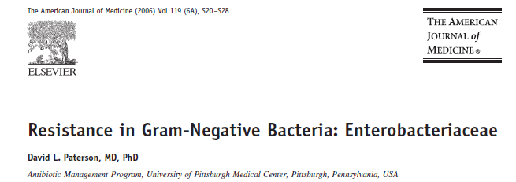
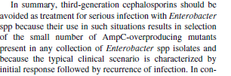

Slide 47
Another Beta Lactamase: Extended Spectrum Beta Lactamases (ESBL)
Plasmid mediated
  Linked with other resistance genes
Derived from “broad spectrum” older beta lactamases known for years such as TEM, SHV, OSA
Substrates include all penicillins, 1st-3rd generation cephalosporins but not cephamycins (cefoxitin/cefotetan) and carbapenems
Inhibited by beta lactamase inhibitors, but PARADOX
  Pip/tazo and others are not clinically effective
  Probably because of other plasmid mediated resistance mechanisms such as Amp C plus porin changes
Treatment of choice was CARBAPENEMS
  Now, ceftolazone/tazo and ceftaz/avi have some activity

Slide 48
The Last Line of Defense
Fortunately, our most potent β-lactam class, carbapenems, remained effective against almost all Enterobacteriaceae.
  Doripenem, Ertapenem, Imipenem, Meropenem
Unfortunately, “Antimicrobial resistance follows antimicrobial use as surely as night follows day”

Slide 49
Carbapenemases in the U.S.
Enzyme | Bacteria
KPC | Enterobacteriaceae
Metallo-β-lactamase | P. aeruginosa
OXA | Acinetobacter spp.
SME | Serratia marcesens

Slide 50
Klebsiella Pneumoniae Carbapenemase
KPC is a class A β-lactamase
  Confers resistance to all β-lactams including extended-spectrum cephalosporins and carbapenems
Occurs in Enterobacteriaceae
  Most commonly in Klebsiella pneumoniae
  Also reported in: K. oxytoca, Citrobacter freundii, Enterobacter spp., Escherichia coli, Salmonella spp., Serratia spp.,
Also reported in Pseudomonas aeruginosa (South America)

Slide 51
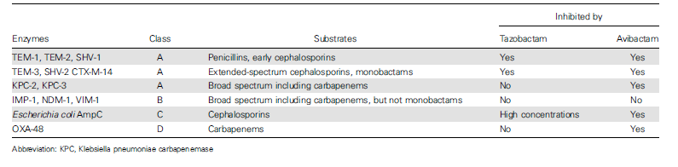
A Primer on Beta Lactamases and Newer BLIs
Van Duin, Bonomo. Clin Inf Dis 2016; 63 (2):234-241

Slide 52
New Delhi Metalloproteinases (NDM-1):
As if we didn’t have enough to worry about!

Slide 53
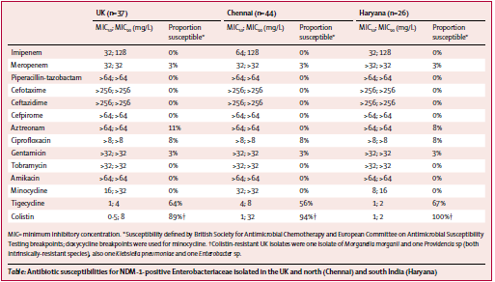

Slide 54
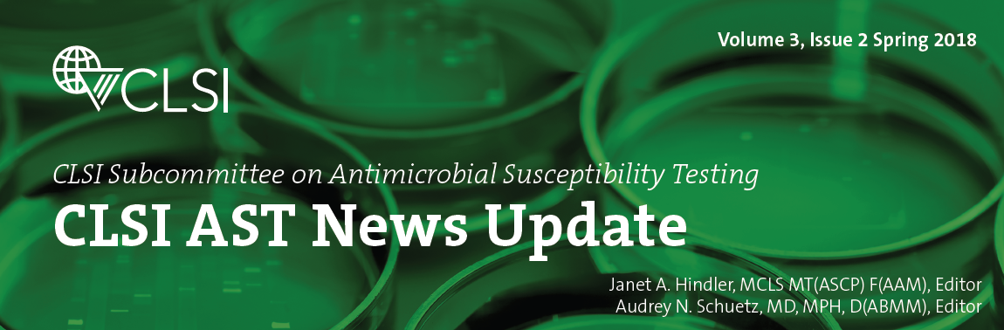
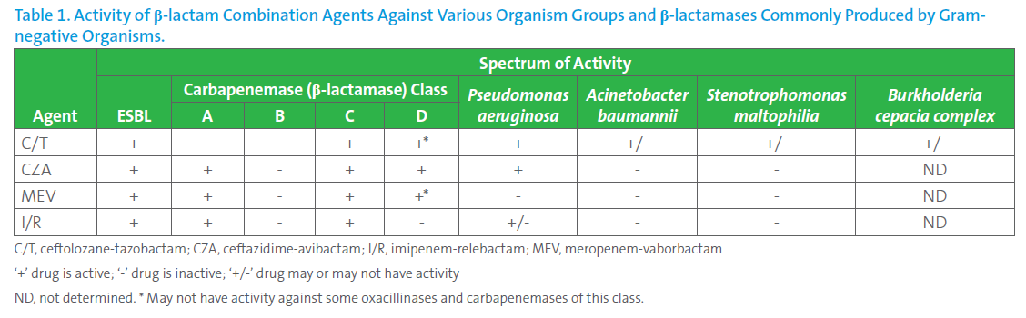
New “Big Gun” Antimicrobials
Hindler, Janet and Audrey Schuetz MD. CLSI AST News Update. 2018; 3(2)

Slide 55
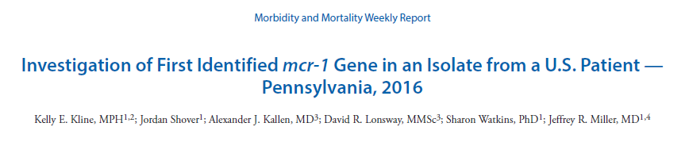
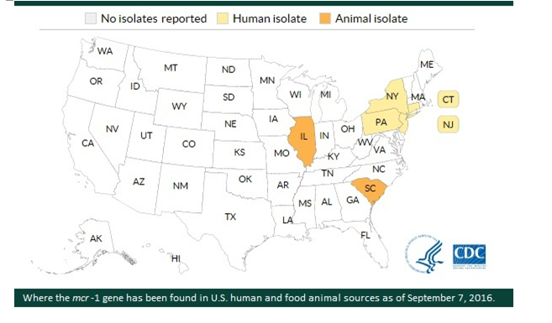
And, As If That Wasn’t Enough!

Slide 56
Resistance Summary
Resistance to most antibiotics is inevitable
Mitigate the damage by
  Enforcing Infection Prevention measures
    Hand Hygiene
    Contact Isolation when appropriate
      Gowns and gloves for patients with MDR organisms
  Antibiotic Stewardship
  Continued research into new mechanisms of antibiotics
    Incentives to PHARM for new drug development
    Extension of patent protection

Slide 57
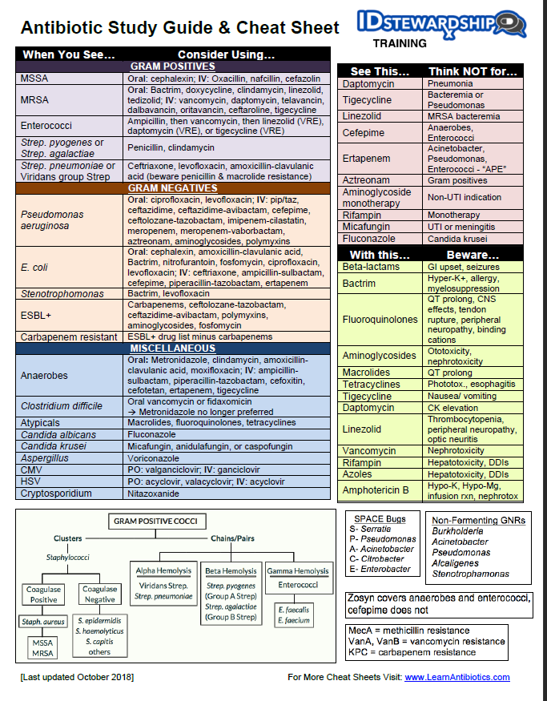
Everything You Wanted to Know…..

Slide 58
Thanks to my collaborators
Carolyn Clayton, MT (ASCP), Phone x 6350
Laura Knoll, MT (ASCP), Phone x 6350
Beverly Dickson, MD, Phone x 7280

